Slide 1
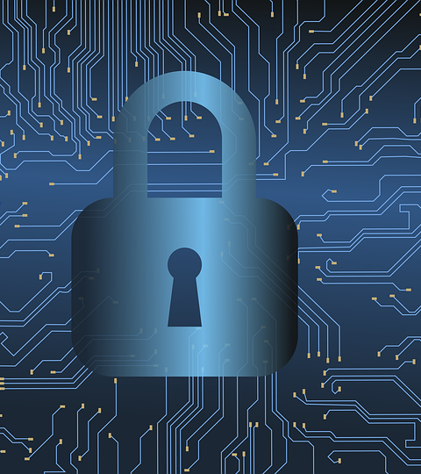

Case Studies of Major Cybersecurity Breaches and Lessons Learned
By Francisco Zecca & Christopher Hernandez

Slide 2
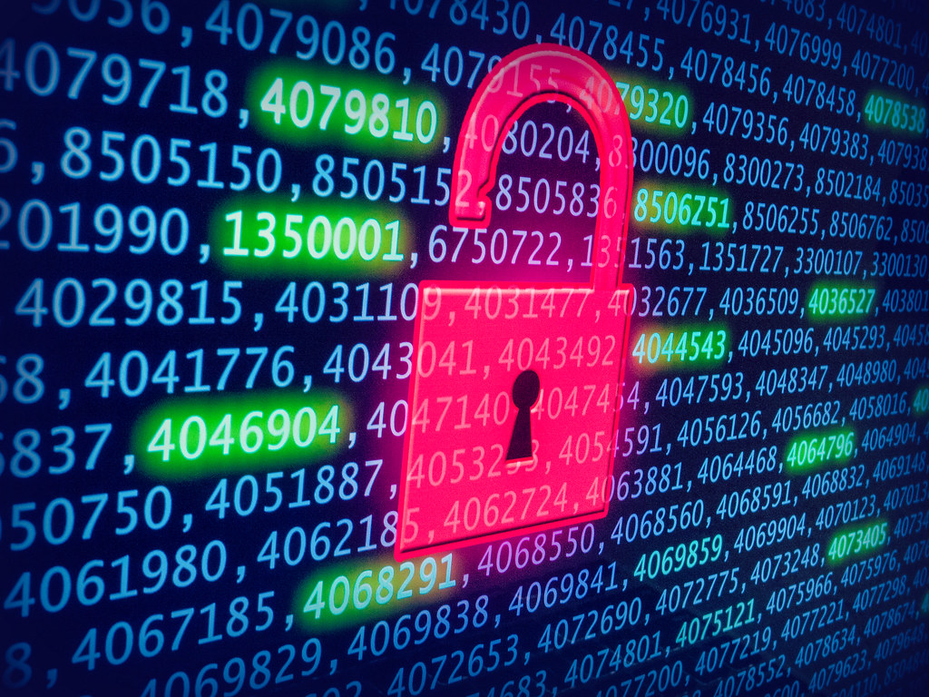
A breach is an incident where an unauthorized person, group, or system gains access to data, networks, devices, or digital services that they are not supposed to access.
A breach can involve unauthorized access to:
Personal data (names, SSNs, addresses, medical info)
Financial data (credit card numbers, bank accounts)
Government or military systems
Corporate intellectual property
Email accounts or messaging platforms
Critical infrastructure (energy, water, healthcare)
Cloud storage or databases
ThePhoto by PhotoAuthor is licensed under CCYYSA.

Slide 3

How do breaches happen?
Breaches often occur due to a combination of:
Weak or stolen passwords
Phishing emails
Malware infections
Software vulnerabilities
Misconfigured cloud systems
Insider threats (accidental or malicious)
Unpatched systems
Lack of encryption
A breach can lead to:
Identity theft
Financial loss
Operational downtime
Loss of national secrets
Damage to reputation
Legal penalties
Strategic disadvantage (in nation-state cases)

Slide 4
US OPM Breach (2015)
What was stolen?
The U.S. Office of Personnel Management (OPM) is the federal agency responsible for:
Full names
SSNs
Addresses
Birthdates
Employment and residency history
Family and foreign contacts
Fingerprints (about 5.6 million sets)
Background investigation forms (SF-86, SF-85P)
Mental health, drug use, financial disclosures
Federal employee records
Security clearance investigations
Personnel background files (SF-86, SF-85, etc.)

Slide 5
Timeline
2013–2014: Initial Breach
Attackers gained entry using a contractor’s stolen credentials.
Malware installed on OPM networks for long-term persistence.
Initial detection tools failed to identify suspicious behavior.
Early 2014: Privilege escalation
Attackers gained administrative-level access.
They began exploring internal systems and databases.
Late 2014: Sensitive databases accessed
Encrypted/root-level background investigation data was quietly exfiltrated.
Attackers used legitimate privileged access to remain hidden.
April 2015: OPM detects unusual activity
Newly deployed monitoring tools identified anomalies.
OPM discovered that personnel data and security clearance data had been stolen.

Slide 6
1. Credential Theft
Attackers used credentials from a government contractor, giving them a foothold in the network.
How the attack worked:
3. Privilege Escalation
Attackers expanded their access using:
Password harvesting inside the network
Administrative rights gained through misconfigured systems
2. Legacy Systems
OPM’s infrastructure was:
Decades old
Poorly segmented
Lacking multi-factor authentication
Missing modern encryption
4. Quiet, Long-Term Persistence
The attackers moved slowly and deliberately:
Hid activity in normal network traffic
Used valid credentials to avoid detection
5. Data Exfiltration
Large datasets were exfiltrated through encrypted channels that blended in with routine traffic.

Slide 7
Who was the Threat actor and Lessons Learned
1. Zero Trust is essential
Do not trust internal traffic or credentials by default.
2. MFA everywhere
The breach exploited single-factor authentication.
3. Legacy systems are national security risks
Critical federal systems require modernization.
4. Contractor access is a major vulnerability
Vendors must meet strict cybersecurity baselines.
5. Continuous monitoring is non-negotiable
Behavioral analytics could have identified the breach earlier.
6. Data minimization reduces impact
Storing enormous troves of sensitive data creates enormous risk.
The U.S. government publicly attributed the breach to state-backed actors associated with China.
Notably:
The operation appeared focused on long-term intelligence collection, not financial gain.
There was no attempt to monetize data on the dark web.
The sophistication, patience, and data type strongly suggested a nation-state espionage goal.

Slide 8
Equifax Data Breach (2017)
What is Equifax?
What was stolen?
Equifax is one of the three major U.S. credit reporting agencies responsible for:
Credit score calculation
Storing sensitive personal financial data
Credit history records for loan and credit approval
Identity verification for banks, lenders, and employers
Full legal names
SSNs
D.O.B
Home addresses
Driver’s license numbers
Credit card numbers of over 200,000 consumers

Slide 9
Timeline of Events
7 Mar. 2017
A serious Apache Struts vulnerability (CVE-2017-5638) is publicly disclosed by the U.S Computer Emergency Readiness Team.
Mar.–Apr. 2017
Equifax does not properly patch the vulnerable system, even though a fix exists.
12 May 2017
Attackers exploit the unpatched Apache Struts vulnerability on an Equifax web application and gain access to the network.
May–July 2017
Hackers stay inside Equifax’s systems undetected, moving through the network and stealing large amounts of sensitive personal data.
29 July 2017
Equifax’s security team notices suspicious network traffic and blocks the attackers’ access.
2 Aug. 2017
An internal investigation and incident response officially begin.
7 Sep. 2017
Equifax publicly announces the breach, revealing that about 147 million people were affected.

Slide 10
How the Equifax attack worked
1. Initial Entry
Hackers exploited a Remote Code Execution (RCE) flaw in the Apache Struts web application framework used by Equifax’s consumer dispute portal allowing them to run commands on the server.
2. Privilege Escalation
Once inside, attackers increased their access rights due to weak access controls, enabling them to reach deeper internal systems beyond the initial entry point.
3. Lateral Movement
Attackers navigated across Equifax’s network using credential harvesting and internal scanning. Poor network segmentation allowed easy movement between systems and databases.
4. Data Extraction & Evasion
Hackers located sensitive databases where data was stored unencrypted and extracted information in small encrypted packets disguised as normal traffic. Ineffective monitoring allowed the activity to go unnoticed for over two months.

Slide 11
Lessons Learned, Attackers Revealed & Outcome
Lessons Learned
Apply critical security patches immediately and verify completion.
Strengthen vulnerability management and real-time monitoring systems.
Encrypt sensitive data at rest and in transit to prevent readable theft.
Maintain active security certificates and improve detection visibility.
Perform regular penetration testing & enforce strong incident response planning.
Attackers Revealed
Attack attributed to a state-sponsored Chinese military hacking group.
February 2020: U.S. DOJ indicted four members of the Chinese People’s Liberation Army (PLA).
The theft was believed to be because they wanted to use the data for government spying and to gather information on U.S. citizens for intelligence purposes.
Outcome
147 million Americans affected — one of the largest data breaches in history.
Severe reputational damage and loss of public trust.
$700M settlement including free credit monitoring and identity restoration.
CEO, CIO, and CSO resigned, showing leadership accountability.
Equifax invested over $1.4B in cybersecurity modernization and restructuring.

Slide 12

Conclusion
Cybersecurity breaches show how even one weak point can lead to major consequences for organizations and the public. The OPM and Equifax cases reveal how attackers can slip into systems, move unnoticed, and steal highly sensitive information. These events highlight the need for strong security practices like timely patching, encryption, and continuous monitoring. Protecting data is an ongoing responsibility that affects businesses, government, and everyday individuals.

Slide 13
